Slide 1
“Washing Line Strategy”
A pedagogical approach to teaching
brief development
Lesley Pearce
National Coordinator Technology
The University of Auckland
February 2013
Notes:
This is about sharing an effective pedagogy I have found really worked with students and allowed lots of fun when introducing subject specific vocabulary.

Slide 2
Aim for this webcast
To explore a teaching strategy to develop deep learning about a concept for technology students

Slide 3
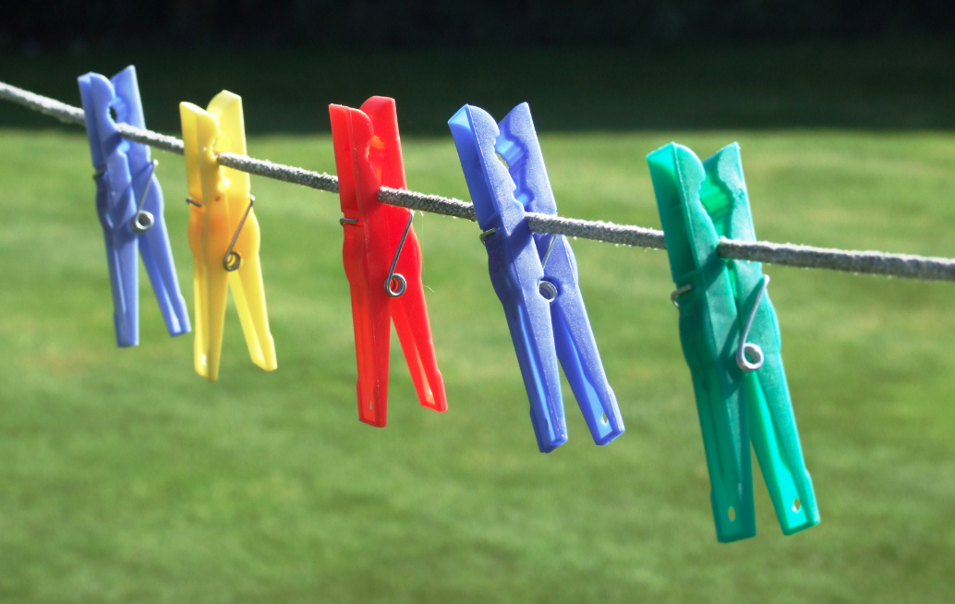
Washing Line Strategy
Aim to generate discussion and thinking around a process for brief development
Notes:
Well used in primary schools where words are pegged to a line to create a sentence.

Slide 4
The washing line strategy is ideal for challenging, engaging and thinking for the whole class to test prior learning or learning from the previous lesson
There are many approaches to this strategy
This is only one approach
Notes:
Only one strategy but this can be taken in many ways to create a collaborative approach to learning.

Slide 5
Aim: to define what brief development is and how it is part of technological practice and not a one off exercise
To do: Discuss in groups of 4 and create a process for brief development using words used in the achievement objective

Slide 6
Prior learning
The academic words are identified in the Achievement Objective – Brief Development
In groups students have a list of words and their meanings and match them up
For each word one student becomes the guardian of the word and ensures they know what this means in relationship to brief development
Notes:
See separate sheet with words and definitions for brief development.

Slide 7
Words such as
Social environment | Physical environment | Exploration | Needs and opportunities
Attributes | Conceptual statement | Context | Fit for purpose
Research | Specifications | What is to be done | Technological Outcome
Issue | Key stakeholders | Wider stakeholders | Measurable standards
Why it should be done | Explanations | Physical nature | Brief
Functional nature | Trialling and testing design ideas | Stakeholder considerations | Authentic
Also give out blank cards
Notes:
For each word write it on card
I also write the action words on card, such as: explore, scope, research, tell a story, identify, trial and test, evaluate
Each student lays their card down in the order they believe fits the process the best. As the guardian of the word they need to justify why they have placed their word where. This generates interesting discussions with the students.

Slide 8

Hand out the washing line sheet
Students can draw their own or the teacher can draw it on the whiteboard or use an actual piece of string and pegs, or just lay it out on the floor.
In groups students discuss the word and put the given words in a process order on the line. Everyone can make one change by justifying why it needs changing.
Post it notes makes rearranging very easy
Notes:
By discussing the order of words for the brief development they will calling on prior knowledge and teaching each other collaboratively

Slide 9
Rules:
Using all the words arrange them into an order of process you would expect to carry out brief development. Place them on the washing line.
Each team member is allowed to move one word in the order and justify the change. Eventually a “process” for brief development should be agreed upon. If any words are part of the same process they can be placed together.
Blank cards are for each group to decide on an aspect that they think is missing. These could be action words. (Or give out action words as well)
Using the action words place them next to the relevant process.

Slide 10
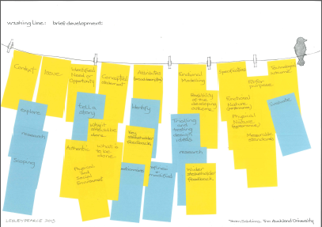
An example: yellow for the main concepts/words, blue for action
Notes:
One example for a layout. Students were given the white sheet of paper with a washing line drawn on it and post it notes.
Yellow and blue paper are post it notes to allow easy movement and some stickability!

Slide 11
Alternative ideas
As students walk into the classroom greet them with a card with one of the words or actions that suggest a process
Students then share with others their word and say what it means.
Students then line up with the the words to create a process then the action word holders are added to the group.

Slide 12
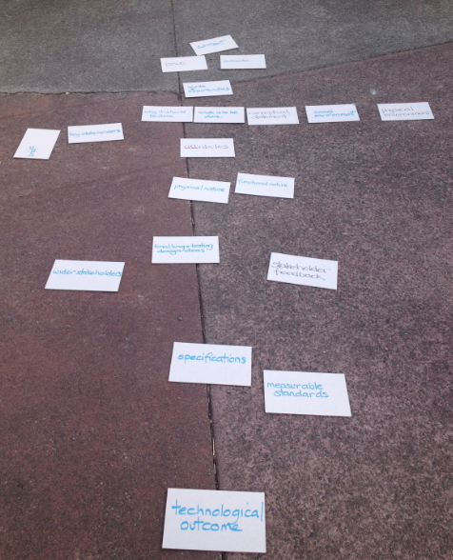
Laying the brief development words onto a pavement after much discussion with each other.
It starts with context and ends with Technological outcome
Notes:
The teacher checks the order and gets students to justify their thinking and corrects the order if needed. The continual talking about the words , their meaning and when they come into play when brief development happens is very powerful.

Slide 13
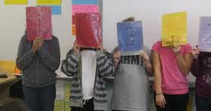
Contextt
Issue
Conceptual statement
Attributes
Explore/research
Tell a story
Notes:
Students could line up themselves and talk about the word and its imporatnce in brief development

Slide 14
Contact details
Lesley Pearce
National Coordinator Technology
The University of Auckland
l.pearce@auckland.ac.nz
Notes:
My email address

