Slide 1
The Language of film
Reading
‘Coraline’
in
( Selick, 2009)

Slide 2
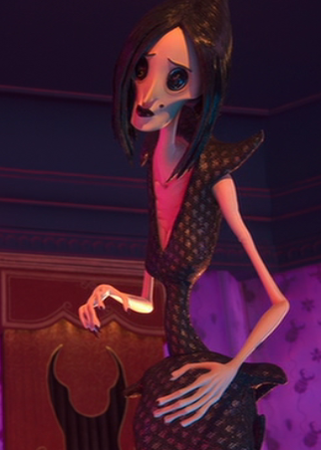
Genre – type of film
‘Coraline’ is a stop motion animated film in the fantasy/ horror genre.
Fantasy – an imaginary world
In which the conflict of
Good against Evil
is the main theme. In fantasy,
normally, evil characters erupt
from their lands to invade and
disrupt the good characters' lives.

Slide 3
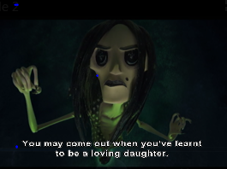
The forces of evil are often personified in a "Dark Lord or ruler". He or she is often depicted as a diabolical (devilish) force, or personality.
Mid shot – MS -
of Other Mother

Slide 4
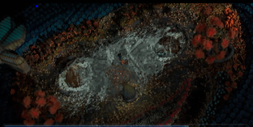
setting
The effects of his or her rule often have bad effects on the land as well as its characters.
A wide angle shot shows the setting and it is also an overhead angle to show Coraline very small and vulnerable in a setting that the Other Mother’s magic has made and she is now destroying to try and trap Coraline.

Slide 5
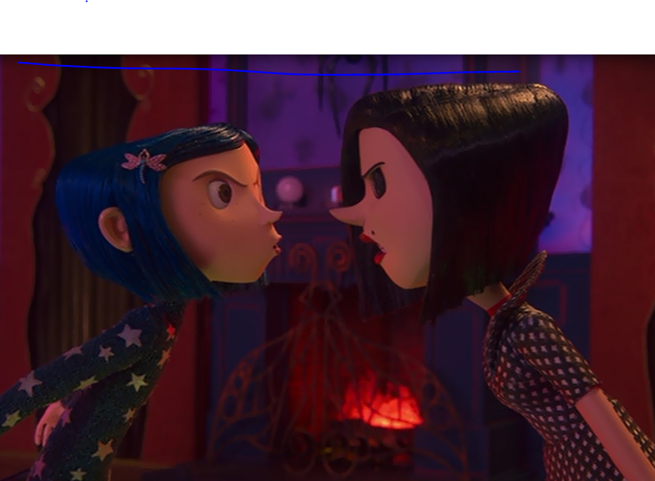
Heroic characters are an element of fantasy. Such characters are capable of extra- ordinary behaviour, physically or morally, or both. While they may at first be less than the role required, they grow into it.
Two shot to show relationship
between characters: Coraline
is surprisingly brave when faced
Other Mother’s true nature

Slide 6
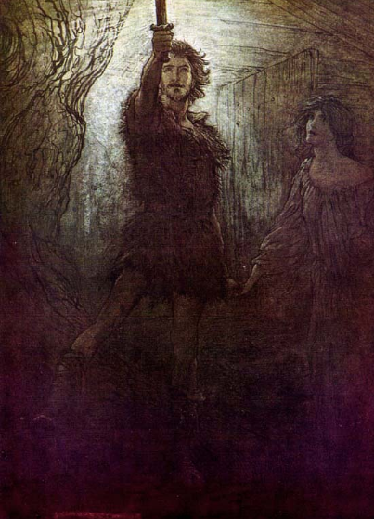
A typical
Hero in
literature

Slide 7
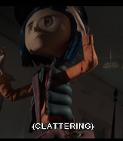
Coraline as the hero
A low angle shot makes the viewer look up at Coraline – this shot angle make s her look powerful as the
Heroine – she is about to go back into the tunnel to rescue her parents.

Slide 8
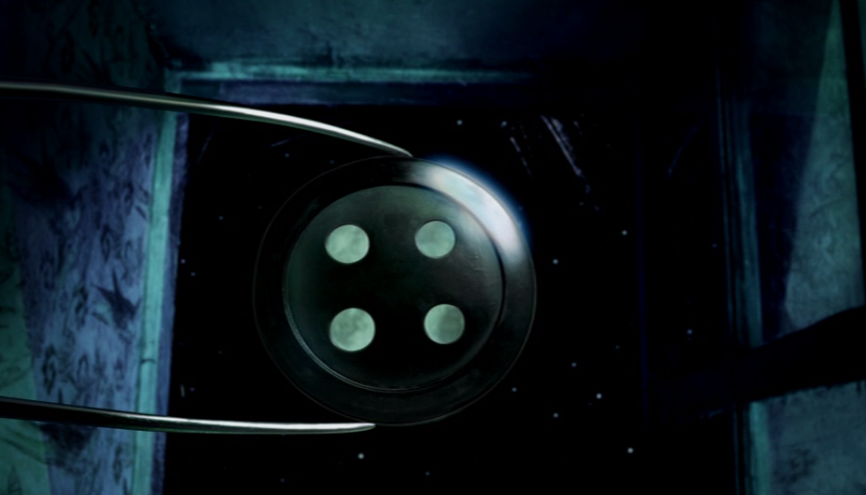
Symbols:
The title sequence often uses symbols to suggest what is going to happen in the story.
The moon is a symbol of madness, and it is used here to suggest the madness of the Other Mother. The button represents the witch’s theft of people’s souls.
.
Extreme Close Up – CU - of the button covering the moon, clasped in the Other Mother’s hand as she sews the Coraline doll with which she will trap Coraline.

Slide 9
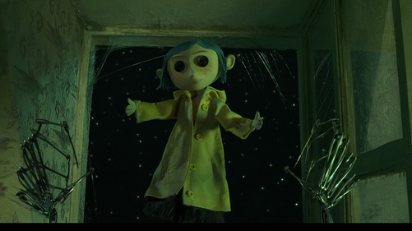
Eyes are sometimes called the windows to the soul: Other Mother covers these with Buttons which represent the theft of the lives – or souls of her victims
The doll in the title sequence is remade from another and sent out to find its way to Coraline so that it can spy on her – Other Mother uses dolls to find children’s weaknesses as she can trap them. The viewer does not know this so the colours and spooky music are what we read to guess all is not good. This called is foreshadowing – warning something bad is to come

Slide 10
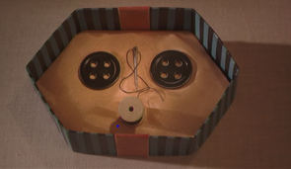
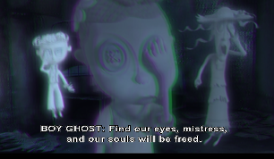
HORROR
Horror is intended to frighten its viewers/readers by inducing feelings of horror and terror: Terror is a feeling of dread that takes place before an event happens,
horror is a feeling of revulsion or disgust after an event has happened.
Other Mother offers Coraline button eyes
Coraline finds the ghost children with button eyes

Slide 11
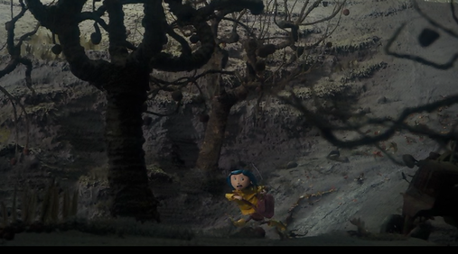
The setting and it’s music in Horror creates an eerie and frightening atmosphere.
Coraline runs for her life in an eye level wide shot that shows the spooky setting by dark colours creepy trees.

Slide 12
vocabulary | meaning
Title sequence: | the shots at the beginning of the film that set the tone – the emotional feel and introduce the audience to the ideas and themes of the film.
Symbolism | Is when a thing represents something else – the moon showing madness
Setting | The time and the place of a story
Close up | Shows a face shot to read emotions of character
Foreshadowing | A warning before something happens
Extreme close up | Shot is really close to focus on a specific thing – like an eye or button
Low angle shot | To make something or one look powerful angled low and looking up
Overhead angle | High above looking down to make the subject look weak or small in their setting
Wide shot | Used at the beginning to establish the world- gives lots of information about setting
Eye level shot | Viewer looks straight at characters – “everything is on the level”

