Slide 1


Supporting English Language Learners
Programmes and Resources

Slide 2
Who are English Language Learners?
English language learners (ELLs) include, but are not limited to:
ESOL-funded students, who may be migrants, refugees, or New
Zealand born
previously funded students who have completed their funding
eligibility term or reached the benchmark
international fee-paying students
students from homes where a language other than English is spoken
students transitioning from Māori-medium to English-medium
learning environments
students from bilingual education settings.

Slide 3

Addressing the needs of ELLs
Schools most effectively address the learning needs of English language learners from diverse backgrounds when they:
identify students with English language learning needs
apply for ESOL funding for students who are eligible
set up appropriate programmes and monitor progress
support diversity and encourage the use of first languages
undertake relevant professional development
develop links with families and communities.
A range of resources has been developed to assist schools to provide this multi-layered support for ELLs.
Most resources can be ordered from ‘Down the Back of the Chair’
phone: 0800 660 662, www.thechair.minedu.govt.nz

Slide 4
Literacy teaching and learning documents
Additional resources and online links
ESOL funding and programme
development
Supporting
English Language
Learners
Supporting diversity and community links
Programme provision and monitoring
Professional development

Slide 5


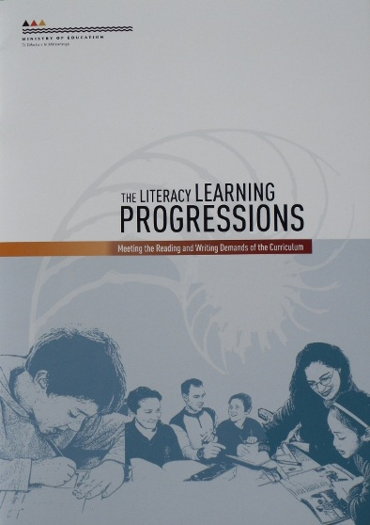
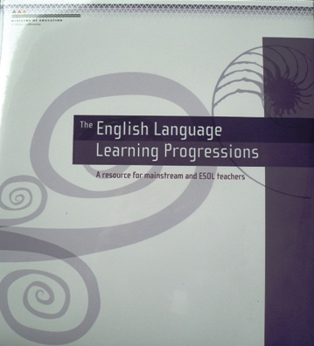

Slide 6
Foundation Documents for Literacy Teaching and Learning in New Zealand
The New Zealand Curriculum
For English-medium teaching and learning in years 1-13
The Literacy Learning Progressions
Meeting the reading and writing demands of the curriculum
Reading and Writing Standards for years 1-8
National Standards
The English Language Learning Progressions
A resource for mainstream and ESOL teachers

Slide 7
Literacy teaching and learning documents
Additional resources and online links
ESOL funding and programme
development
Supporting
English Language
Learners
Supporting diversity and community links
Programme provision and monitoring
Professional development

Slide 8

English for Speakers of Other Languages Folder
This folder contains the following booklets:
Funding Assessment
Guidelines
Refugee Handbook for Schools
Effective Provision for
International Students
NESB Students: A Handbook for
Schools
Progress Assessment
Guidelines.

Slide 9

ESOL Funding Assessment Guidelines
Assists teachers to assess their ELLs against the criteria in the ESOL Assessment Form (ESOL/AF) for the purposes of funding.
Discusses the concept of ‘cohort’ and ways of measuring students against the national cohort.
Each section (listening, speaking, reading and writing) includes student exemplars and assessment samples.
MOE: ESOL Funding Assessment Guidelines

Slide 10

Refugee Handbook for Schools
Supports schools in meeting the particular needs of students from refugee backgrounds, especially at key transition points.
Focuses on developing programmes which support students with a range of social and academic needs.
Emphasises the importance of providing family support and developing wider community networks.
MOE: Refugee Handbook

Slide 11

Effective Provision for International Students
Discusses ways of developing effective business plans and meeting formal obligations for these students.
Offers suggestions for providing quality ESOL support for international students.
Emphasises the importance of pastoral care.
MOE: Effective Provision for International Students

Slide 12
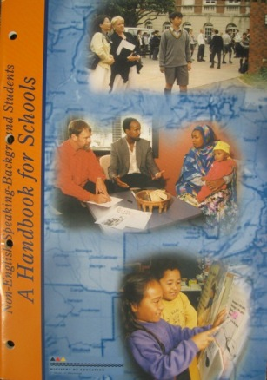
Non-English Speaking Background Students
A Handbook for Schools
Provides information and suggestions for Boards of Trustees, principals and staff regarding appropriate and effective support for ELLs from years 1-13.
Discusses the factors that affect the learning of ELLs, and steps for developing effective ESOL and mainstream classroom programmes.
Chapter 3 provides suggestions for the development of school-wide policies and procedures.

Slide 13

Progress Assessment Guidelines
Provides information about a range of assessment tools and processes used in New Zealand schools.
Explains how these tools can be used to assess the language learning needs and describe the progress of English language learners.
Discusses the purpose of diagnostic, formative and summative assessment.

Slide 14
Literacy teaching and learning documents
Additional resources and online links
ESOL funding and programme
development
Supporting
English Language
Learners
Supporting diversity and community links
Programme provision and monitoring
Professional development

Slide 15




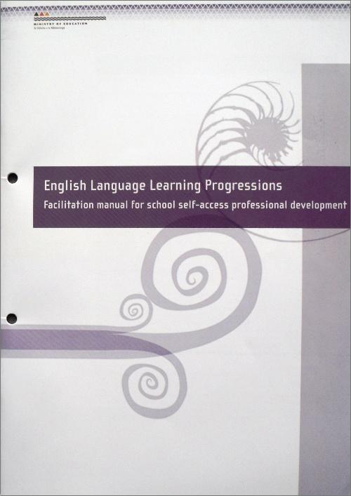


Slide 16
ELLP
English Language Learning Progressions
Mainstream and ESOL teachers can use ELLP to monitor ELLs’
progress in speaking, listening, reading and writing.
An introductory booklet and years 1-4, 5-8 and 9-13 booklets contain
extensive background information and annotated student exemplars.
The DVD demonstrates the oral language monitoring process by
analysing student interviews against the criteria.
The Facilitation Manual provides a series of seven professional
development modules for use with a whole staff.
Notes:
Online

Slide 17


SELLIPS
Supporting English Language Learners in Primary Schools
Provides suggestions for developing students’ academic, cross-curricular English language in both mainstream and transitional classes.
Presents ways in which teachers can scaffold the learning of ELLs so that they can achieve learning outcomes at their appropriate stages.

Slide 18


English Language Intensive Programmes (ELIP)
Primary Resource and Years 7-13
These folders and CDs offer key programming guidelines for beginning to advanced ELLs.
Language skills are illustrated with scaffolded texts in Oral Interaction, Reading, Understanding and Responding, and Writing.
Each unit includes orientation to learning section, suggested teaching components and sample strategies.

Slide 19


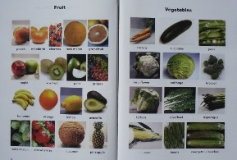
AUT Picture Dictionary and Teaching Resource
A New Zealand based picture dictionary for new learners of English.
Introduces over 1,000 high frequency words used in daily life in topic groups.
The teaching resource features an extensive list of learning tasks linked to the dictionary pages.

Slide 20
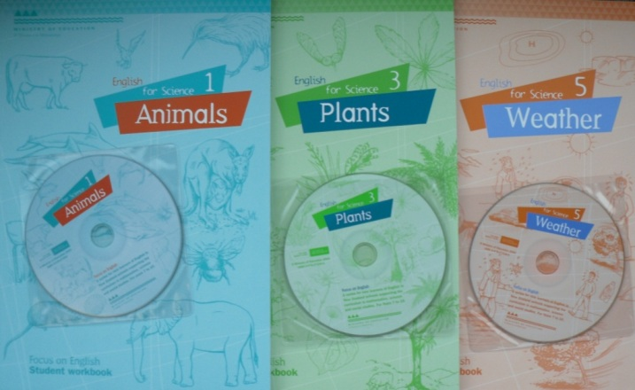
Focus on English
A series of six modules for ELLs in years 7-10. The topics support the curriculum in science, mathematics and social sciences.
Teachers can focus on high frequency vocabulary, technical terms and basic language features which support classroom topics.
The complete set is: Animals, Shapes, Plants, Measurement, Weather and Conservation.

Slide 21
Reading Resources
The Ministry of Education has developed a range of reading resources aimed at engaging English language learners. These include high interest fiction and non-fiction topic-based readers.
Series titles are:
Ready to Read Selections
Selections
Choices
Applications
Electronic Story Books
Tupu Readers (in five Pasifika languages)
Teacher notes and CDs are included with many of these resources.

Slide 22



Ready to Read Selections
Carefully chosen Ready to Read titles from the ‘early’ and ‘fluency’ levels of the colour wheel which are suitable for ELLs in years 7-13.
Teachers’ notes are designed to assist teachers to use the texts as learning tools for teaching reading and related aspects of English language.

Slide 23
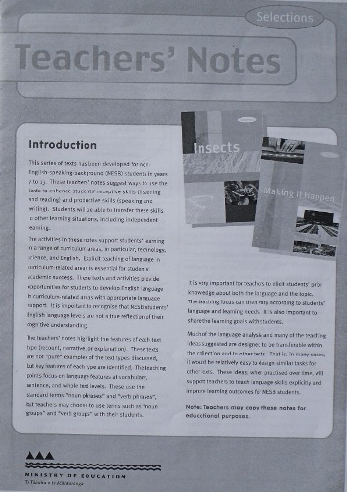


Selections
Includes titles appropriate for use with ELLs in years 7-13.
An extensive set of teachers’ notes enable ESOL and mainstream teachers to integrate English language learning with ‘learning to read’ and ‘reading to learn’ in a range of topics.
Other titles include Making It Happen, Animal Rescue, Maths in Action, and Design in Action.

Slide 24

Choices
A series of theme-based collections designed to provide high-interest reading and listening material for junior secondary students.
The series supports students who find classroom reading material difficult in a range of curriculum areas.
Danger! was designed specifically for ELLs with a vocabulary level over 2000 words. An audio tape and teachers’ notes are included.

Slide 25



Applications
Texts present scientific information and examples of technological practice for secondary students in the context of real-life problems and experiences.
Concept maps linking to science and technology topics are provided for each title.
Teachers’ notes include specific approaches for science and technology teachers.

Slide 26
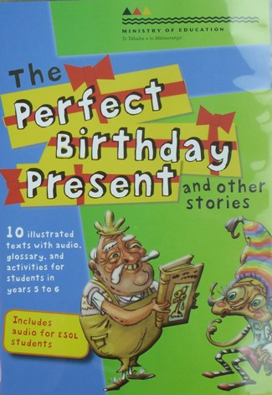



Electronic Story Books
A series of stories with audio recordings and teachers’ notes. The stories have been adapted from Connected, School Journals, and Choices series.
These high interest stories are of particular interest to reluctant readers in years 5-10.
Glossary definitions and activities that encourage students to respond to the text are included.

Slide 27




Tupu
Illustrated fiction, non-fiction and poetry published by Learning Media for the Ministry of Education in Cook Islands Maori, Niuean, Samoan, Tokelauan and Tongan.
Teachers’ notes include a summary of the story in English and a range of activities to engage the student with the text.
The series also includes CDs.

Slide 28
Literacy teaching and learning documents
Additional resources and online links
ESOL funding and programme
development
Supporting
English Language
Learners
Supporting diversity and community links
Programme provision and monitoring
Professional development

Slide 29

Effective Literacy Practice
Three texts which focus on the dimensions of Effective Practice: Knowledge of the learner, Knowledge of literacy learning, Expectations, Instructional Strategies, Engaging learners with texts and Partnerships.
Specific literacy pathways for English language learners are discussed.
Available for three levels:
Years 1-4, 5-8 and 9-13

Slide 30


Learning Through Talk
Emphasises the key role of oral language in supporting students’ learning.
Provides extensive information and relevant resources for supporting ELLs in developing oral language skills.
Topics include Knowledge of the Learner, Instructional Strategies, Engaging Learners with Talk, Expectations and Partnerships.

Slide 31
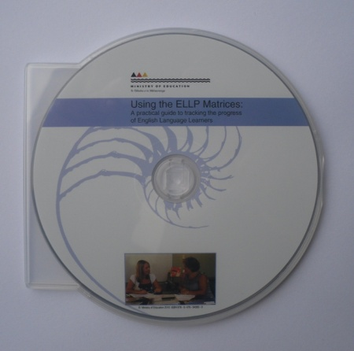
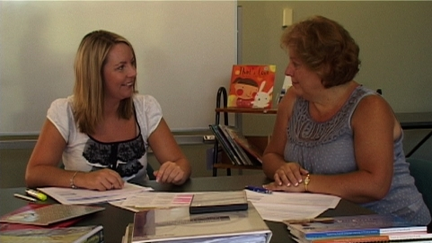
Using the ELLP Matrices
A practical guide to tracking the progress of ELLs
This DVD is a practical guide to making an overall teacher judgement on an ELL’s ability and stage in the areas of: Oral Language (Speaking), Oral Language (Listening), Reading and Writing.
It is designed to be used for individual, small group or whole staff professional development. Each section is up to six minutes in length and shows two teaching colleagues discussing a student’s work and language ability in relation to the ELLP stages.

Slide 32

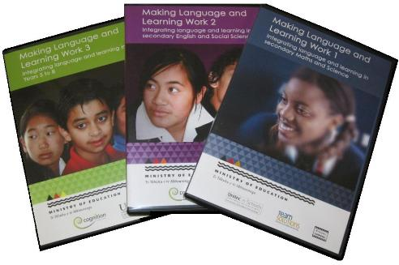
Making Language and Learning Work
DVDs 1, 2 and 3
DVD 1 (Secondary Maths and Science), DVD 2 (Secondary English and Social Sciences) and DVD 3 (Years 5-8) provide practical examples of best practice for teaching ELLs in mainstream classrooms.
Schools can use the DVDs to provide professional development using the ‘Play by Principles’ or ‘Play by Subject’ options.
Teacher booklets provide background information and suggested approaches.

Slide 33

Working with English Language Learners Handbook and DVD
A 10 module professional development programme for teacher aides and bilingual tutors.
Co-ordinating teachers are essential for the success of the programme. They facilitate each module and act as a mentor.
The DVD includes video clips, a list of resources and a copy of the course completion certificate.

Slide 34
Literacy teaching and learning documents
Additional resources and online links
ESOL funding and programme
development
Supporting
English Language
Learners
Supporting diversity and community links
Programme provision and monitoring
Professional development

Slide 35

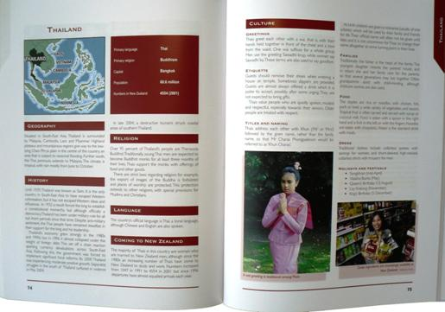
New to New Zealand
A Guide to Ethnic Groups in New Zealand
Provides information about some ethnic groups living in New Zealand.
Includes comments about the geography, history, religion, language and culture of each group.
Pages can be added to ethnic boxes or given to teachers to develop knowledge about new students.

Slide 36
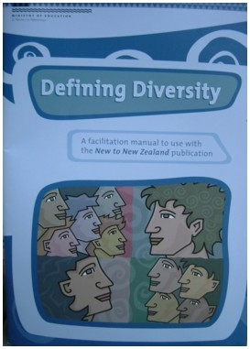
Defining Diversity
A Facilitation Manual to use with New to New Zealand
Links to New to New Zealand providing twenty practical tasks based on the key principle, ‘Know your learner’.
Target audiences include boards of trustees, senior management, teachers and parents.
Schools may enlist the help of bilingual tutors and community members to work through the activities.

Slide 37

Home School Partnership Programme
A programme which assists schools to connect with parents regarding literacy and numeracy practices for students in years 1-8 and to support student learning and career choices in years 9-13.
Schools can develop their own programmes by downloading materials from the website. Assistance is also available through School Support Services Advisors.
TKI: Home-School Partnership Programme

Slide 38


National Standards Multilingual Information
‘How well is my child doing?’ pamphlets provide an overview of National Standards for families of migrant and refugee background students.
‘Supporting Your Child’s Learning’ booklets (in 14 languages) can be used with families:
to explain how what happens at school and what happens at home interconnect to support learning
to talk with parents about a child’s literacy and numeracy, and with students about their goals
to include in enrolment packs, newsletters and reports
for ideas and activities parents and children can do together during the holidays.

Slide 39

Helping Your Children Learn At Home And At School
Refugee and Migrant Parent Booklets
Aimed at migrant and refugee parents and families.
Use first languages to explain the New Zealand education system from ECE to secondary school.
Discuss a range of social and educational challenges facing ELLs.
These booklets are currently available in:
Afrikaans, Arabic, Chinese, Cook Island Maori, Dari, French, Hindi, Korean, Niuean, Samoan, Somali, Tagalog, Thai and Tongan.

Slide 40

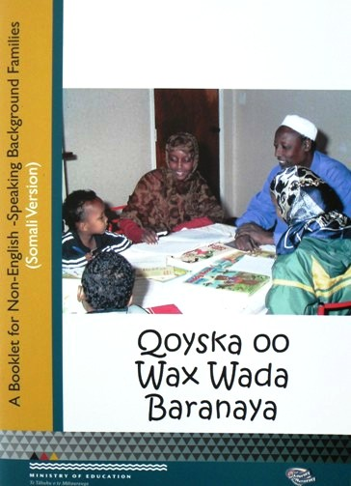
Families Learning Together Booklets
Provide information about the New Zealand education system in Amharic, Arabic, Chinese, Farsi, Hindi, Khmer, Korean and Somali.
Offer advice for parents on how to become more involved in their child’s learning through a range of listening, speaking, reading and writing activities.

Slide 41
Literacy teaching and learning documents
Additional resources and online links
ESOL funding and programme
development
Supporting
English Language
Learners
Supporting diversity and community links
Programme provision and monitoring
Professional development

Slide 42

ESOL Online
An online service for teachers of students in years 1-13 which includes:
a range of strategies and approaches for teaching ELLs
units of work including NCEA units
a resource exchange facility
professional readings
an ‘e’ forum which teachers can subscribe to
links to relevant websites.
esolonline.tki.org.nz

Slide 43

Ministry of Education Website
The ESOL pages include information about:
ESOL funding and support initiatives
Professional development, including information about TESSOL
scholarships
Materials and resources, including multilingual notices and forms
in several languages
ESOL News Updates.
www.minedu.govt.nz/esol

Slide 44

Contacts
This pamphlet, which has been sent to schools with ESOL funded and international students, contains contact details for:
The National Migrant, Refugee and
International Education Team
The Curriculum Teaching and Learning Team
Regional Migrant and Refugee Education
Co-ordinators
ESOL/Literacy Facilitators.

